Slide 1

Economies and Diseconomies of Scale

Slide 2

Returns to Scale
Increasing returns to scale
  When the % change in output > % change in inputs
    E.g. a 30% rise in factor inputs leads to a 50% rise in output
  Long run average total cost will be falling
Decreasing returns to scale
  When the % change in output < % change in inputs
    E.g when a 60% rise in factor inputs raises output by only 20%
  Long run average total cost will be rising
Constant returns to scale
  When the % change in output = % change in inputs
  E.g when a 10% increase in all factor inputs leads to a 10% rise in total output
  Long run average total cost will be constant

Slide 3
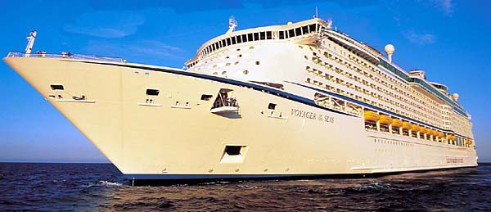
The Law of Increased Dimensions
How does this show increased dimensions?
What affect does this have on FC, AC and MC?

Slide 4
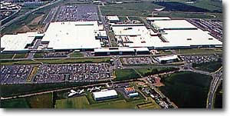
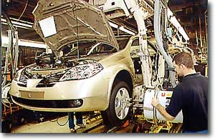
So why does car manufacturing take place on such a large scale?

Slide 5
Internal Economies of Scale
Technical Economies of Scale
  The Law of Increased Dimensions
    Cubic law can be applied where cubic volume increases more than proportionate to surface area
  Economies of linked processes
    Production processes can linked together with one integrated plant – important in mass production which requires complex manufacturing processes
  Large-scale indivisible units of capital machinery
    Capable of high productivity (e.g. presses used in the manufacture of steel products)
    Huge units of capital require a vast output in order to reduce the average cost per unit
  Specialisation and Division of Labour

Slide 6
Scale Economies Continued
Marketing Economies
    Expensive advertising spending can be spread over huge volumes of sales – reduces the marketing costs per unit
Risk-Bearing Economies (lower risks)
    Diversification of products – multi-product firms
    Diversification of plant locations / retail outlets – including the expansion of multinational business
Managerial Economies
    Savings in administrative costs by splitting up jobs (e.g. specialist buyers, production management)

Slide 7
Scale Economies (3)
Financial Economies
  Bulk purchasing economies
    Monopsony power of buyers of components)
  Access to cheaper sources of finance
    Lower interest rates for larger businesses
    E.G. share issues and corporate bond finance
Learning Economies
    Efficiencies due to the length of experience in a market
    Readily available in high-knowledge industries
    “Learning by doing” “Tricks of the trade”

Slide 8
The long run average cost curve
ILLUSTRATING ECONOMIES AND DISECONOMIES OF SCALE
Costs
Productive efficiency in the long run is achieved when output is produced at the bottom of the long run average cost curve
SRAC1
SRAC3
SRAC2
AC1
LRAC
AC2
AC3
Q1
Q2
Q3
Output (Q)

Slide 9
Illustrating economies of scale
Costs
Revenues
ECONOMIES OF SCALE ALLOW LOWER ATC, LOWER PRICES AND HIGHER PROFITS
SRAC1
P1
Economies of scale as a business achieves plant economies of scale and can move onto a lower average cost curve
Total Revenue
SRAC2
Profits
P2
AC1
SRAC cost
AC2
Demand
So why is Quantity produced at the lowest point of the SRAC curve?
So why is Quantity produced at the lowest point of the SRAC curve?
Q1
Q2
Quantity Produced (Q)

Slide 10


Economies of Scope
Where it is cheaper to produce a range of products than to produce each individual product on its own
McDonalds hamburgers and french fries share the use of food storage and preparation facilities
Proctor & Gamble
  P&G owns over 250 brands, including Pringles crisps, Crest toothpaste, Max Factor make up and Pampers nappies
  Graphic designers and marketing experts can use their skills across hundreds of product lines
Car manufacturers
  Car panels / interiors are common to a range of models
Airlines
  If an airline has a hub and spoke network then adding one more route to its network creates many more potential transfer routes for the airlines customers

Slide 11
Evaluation: Potential Limits to Economies of Scale
Limited total market demand for many products
  Market demand may be insufficient for businesses to fully exploit the scale economies
  “Niche markets” allow smaller-scale producers to supply at higher cost because consumers are willing to pay a higher price
  Falling demand in a recession - capital will be under-utilised leading to excess capacity and rising average total costs
Occupational immobility of capital equipment
  Some large units of fixed capital may not be transferable to other uses if there is a sudden switch in consumer demand.
Diseconomies of scale
  A business may expand beyond the optimal size in the long run and experience diseconomies of scale

Slide 12
External Economies of Scale
External economies of scale exist when the long-term expansion of an industry leads to the development of ancillary services which benefit all or the majority of suppliers in the industry
  A labour force skilled in the specific crafts of the industry
  Components suppliers equipped to supply the right parts re-locate close to production centres – reducing transportation costs
  Trade magazines in which all firms can advertise cheaply and disseminate information
  Development of industry-specific research capabilities in local universities
External economies partially explain the tendency for firms to cluster geographically
Good examples to quote
  Car industry in the West Midlands
  Silicon Valley & its pool of computer experts
  Financial services industry in London and New York

Slide 13

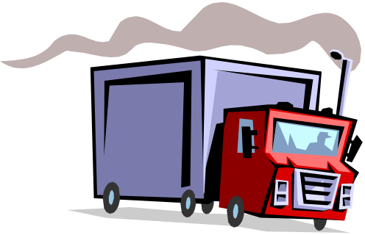
Law of Increased Dimensions
Warehousing/Storage
Transportation
Food Retailing
Super-Cruisers
Hotels
Transatlantic airlines
Motor manufacturing
Oil & Gas distribution

Slide 14
Diseconomies of Scale
Diseconomies of scale leads to rising long-run average costs
  LRAC rises due to firms expanding beyond their optimum scale
  Diseconomies are difficult to identify precisely
They are often caused by the complex nature of managing large-scale firms and in managing the growth of a business
  (1) Costs of administration and coordination of the workforce
  (2) The growth of corporate bureaucracy (i.e. which might be seen in excessive layers of management)
  (3) The risk of worker alienation or shirking because of the problems in monitoring the effectiveness of workers
  (4) Differences in the optimum scale of units of capital
  (5) An increase in transportation costs to distant markets
Diseconomies can lead to a misallocation of scarce resources if firms do not achieve long run productive efficiency

Slide 15
External Diseconomies of Scale
These occur when too many firms have located in one area
Local labour becomes scarce and firms now have to bid wages higher to attract and retain new workers
Land and factories become scarce and rents begin to rise
The local traffic infrastructure become congested and so transport costs begin to rise

